Slide 1
Cisco Webex Contact Center Agent Desktop
Customer Solution Assurance Team
[Presenter]
[DATE]

Slide 2
Agent Agenda
Account activation
Agent Login
Agent Desktop Overview
Agent States
Manage inbound calls
Outbound Calls
Agent Personal Statistics
Help
Q&A

Slide 3
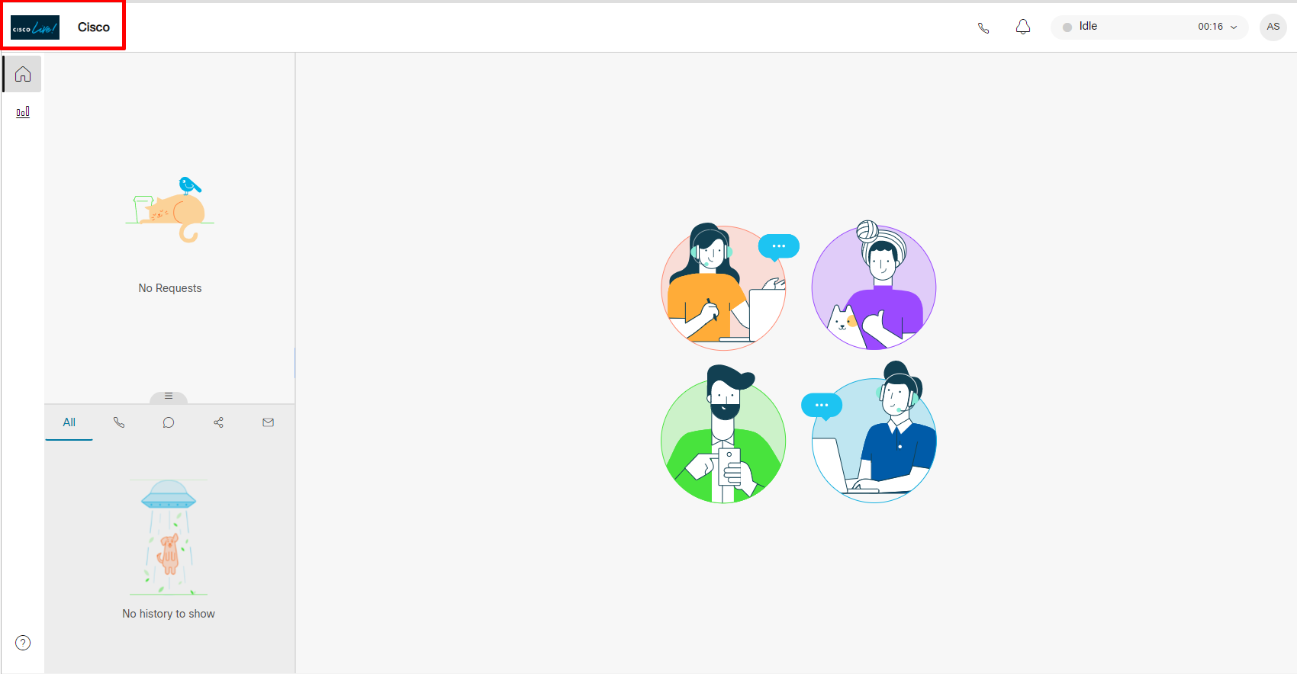
Part 1: Agent Desktop - 1.2 Create a Custom Desktop Layout

Slide 4
Part 1: Agent Desktop - 1.2 Create a Custom Desktop Layout

Slide 5
Account Activation

Slide 6
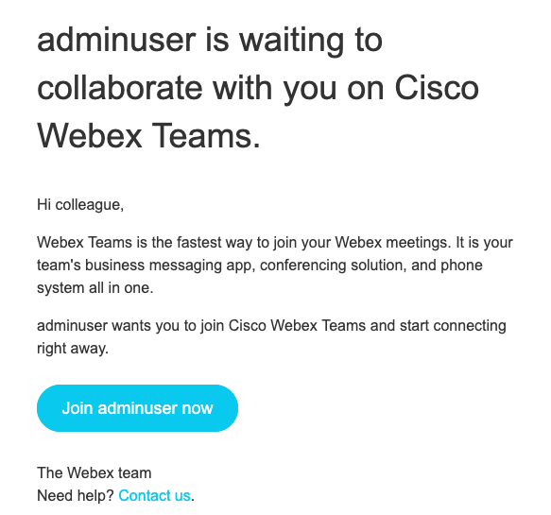
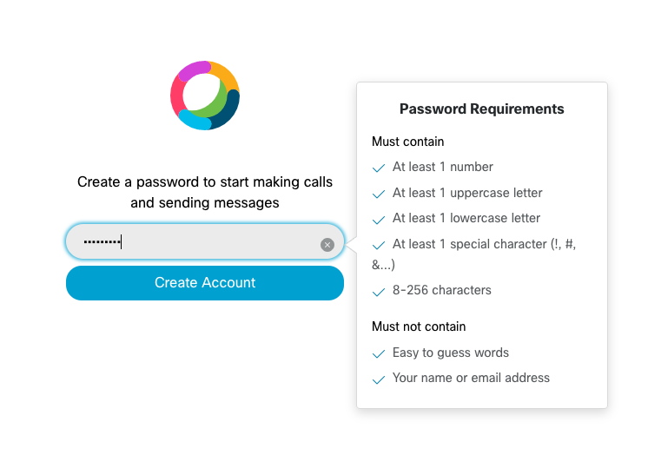
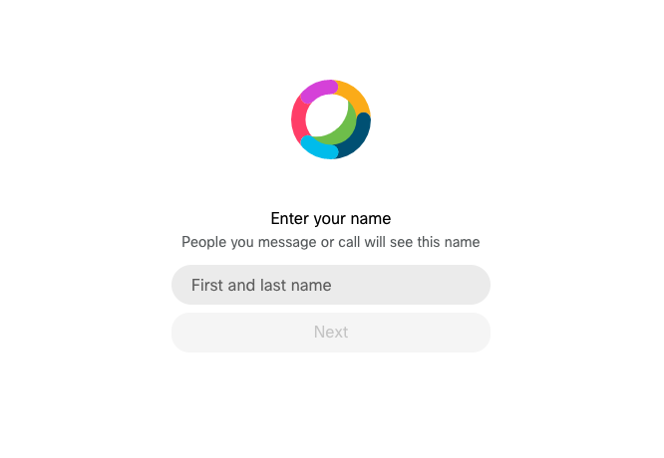
Account activation
End customer to complete enrollment using the activation link received in mail.
Set password as per requirements
Set First and last Name and select ‘Next’

Slide 7
Agent Login

Slide 8
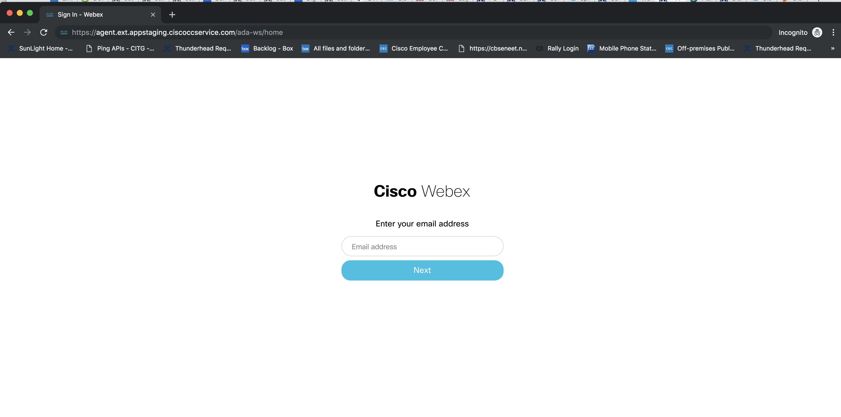
Login URL
Login to the URL - <Replace with your AppCenter URL> using agent credentials
Agent Desktop EU1 URL: https://desktop.wxcc-eu1.cisco.com

Slide 9
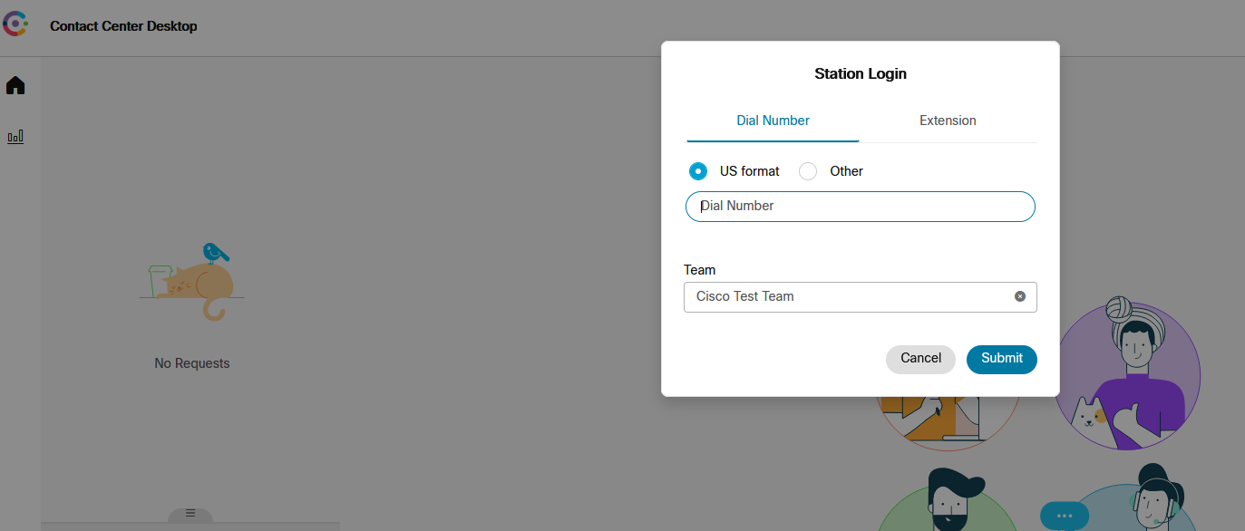
Station Login
*NOTE: Use ‘00’ instead of ‘+’ for the country extension
Enter a DN, Select a Team and Save changes. The DN is the Dialed Number where the agent can be reached for voice interactions.

Slide 10
Agent Desktop Overview

Slide 11
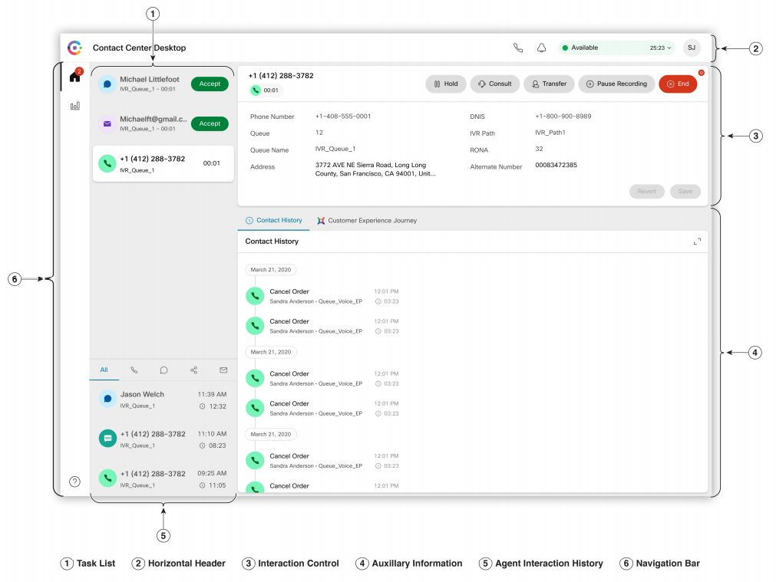
Agent Desktop Overview

Slide 12
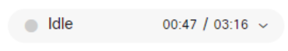
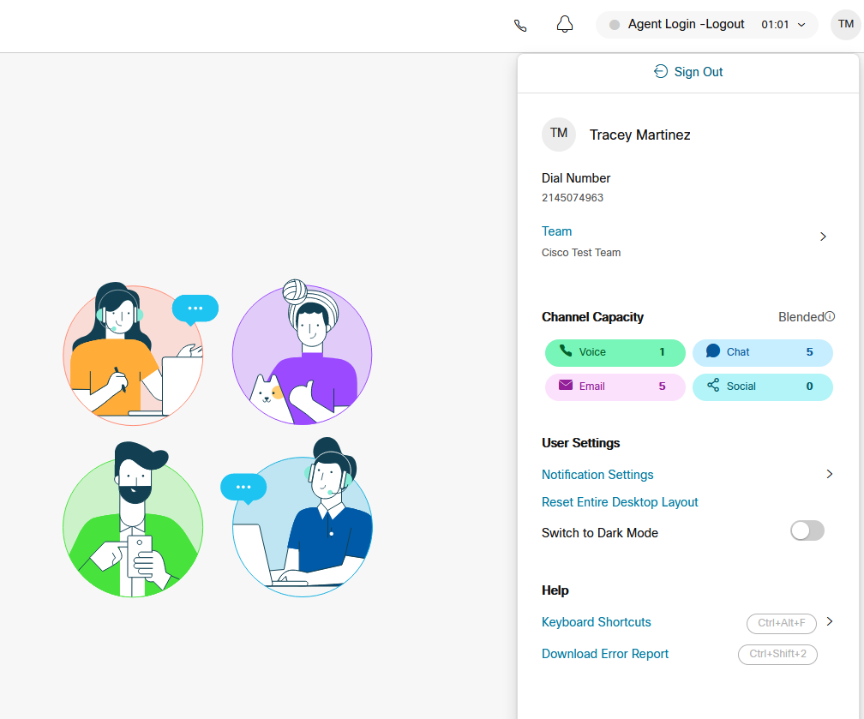
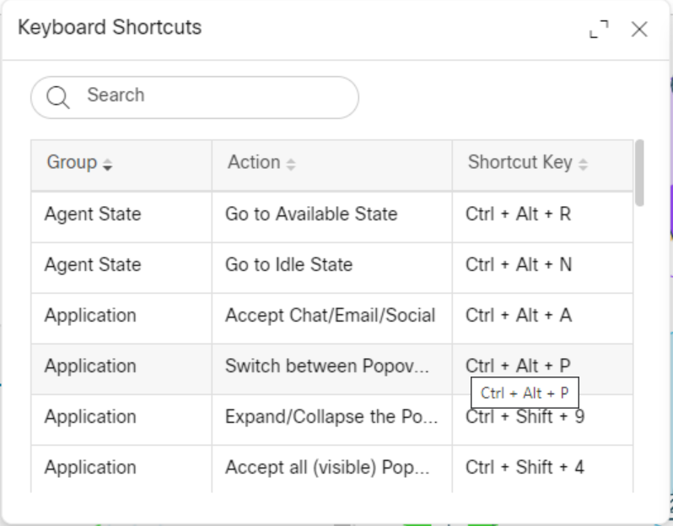
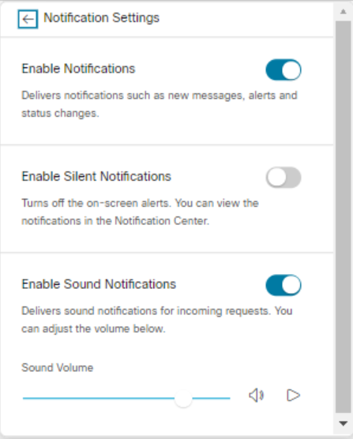
User settings
When an agent has finished a shift or needs to sign-out from the contact center for any other reason (like to change phone numbers)

Slide 13
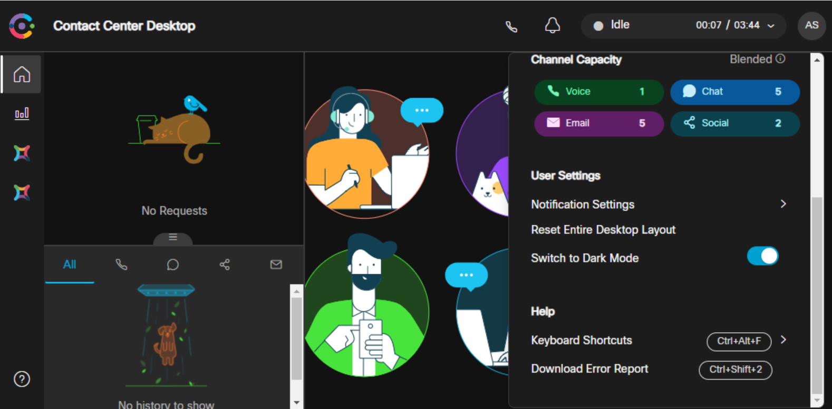
Dark Mode

Slide 14
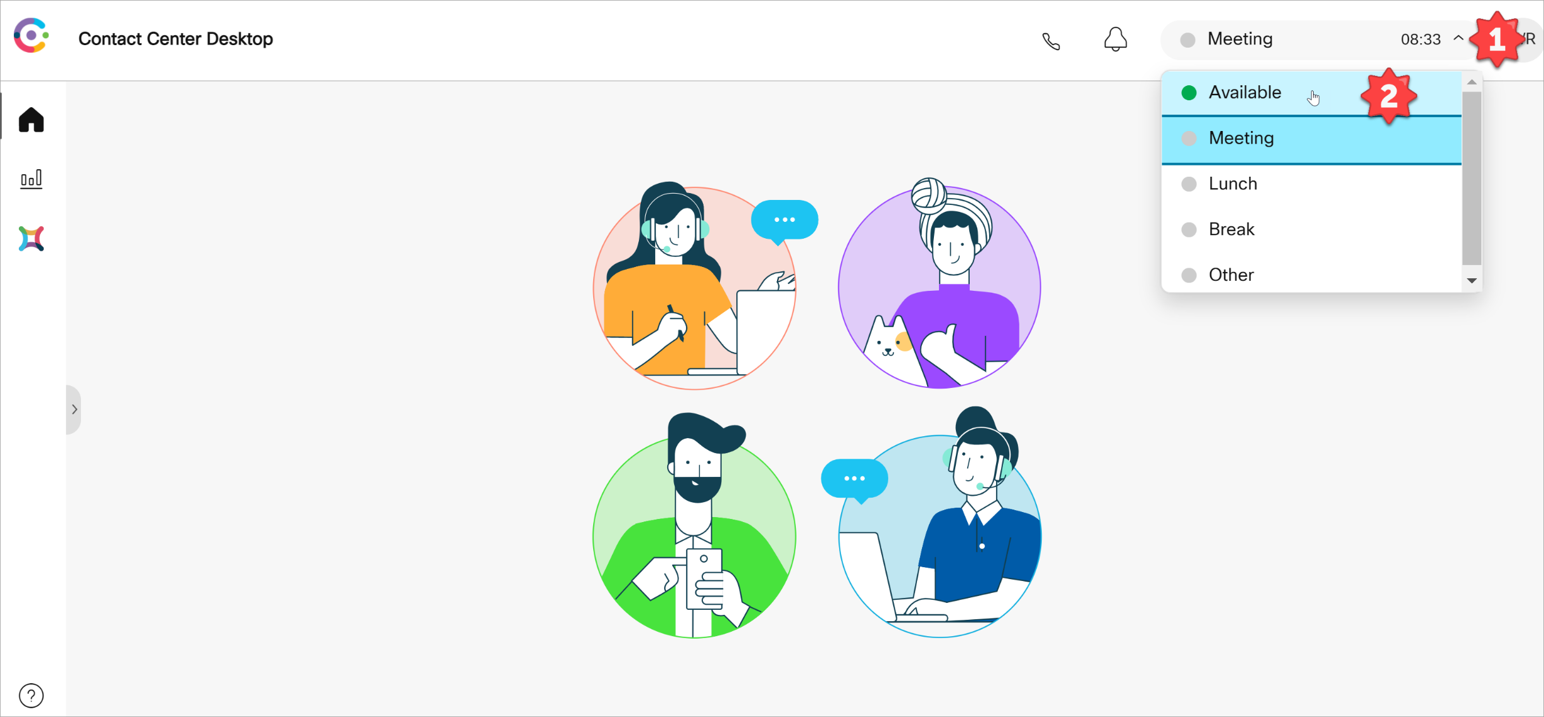
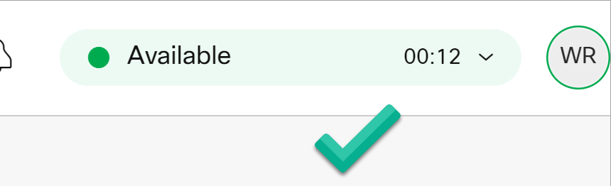
Agent States
Set status to ‘Available’ state to receive interactions (calls) from the queue

Slide 15
Agent States

Slide 16
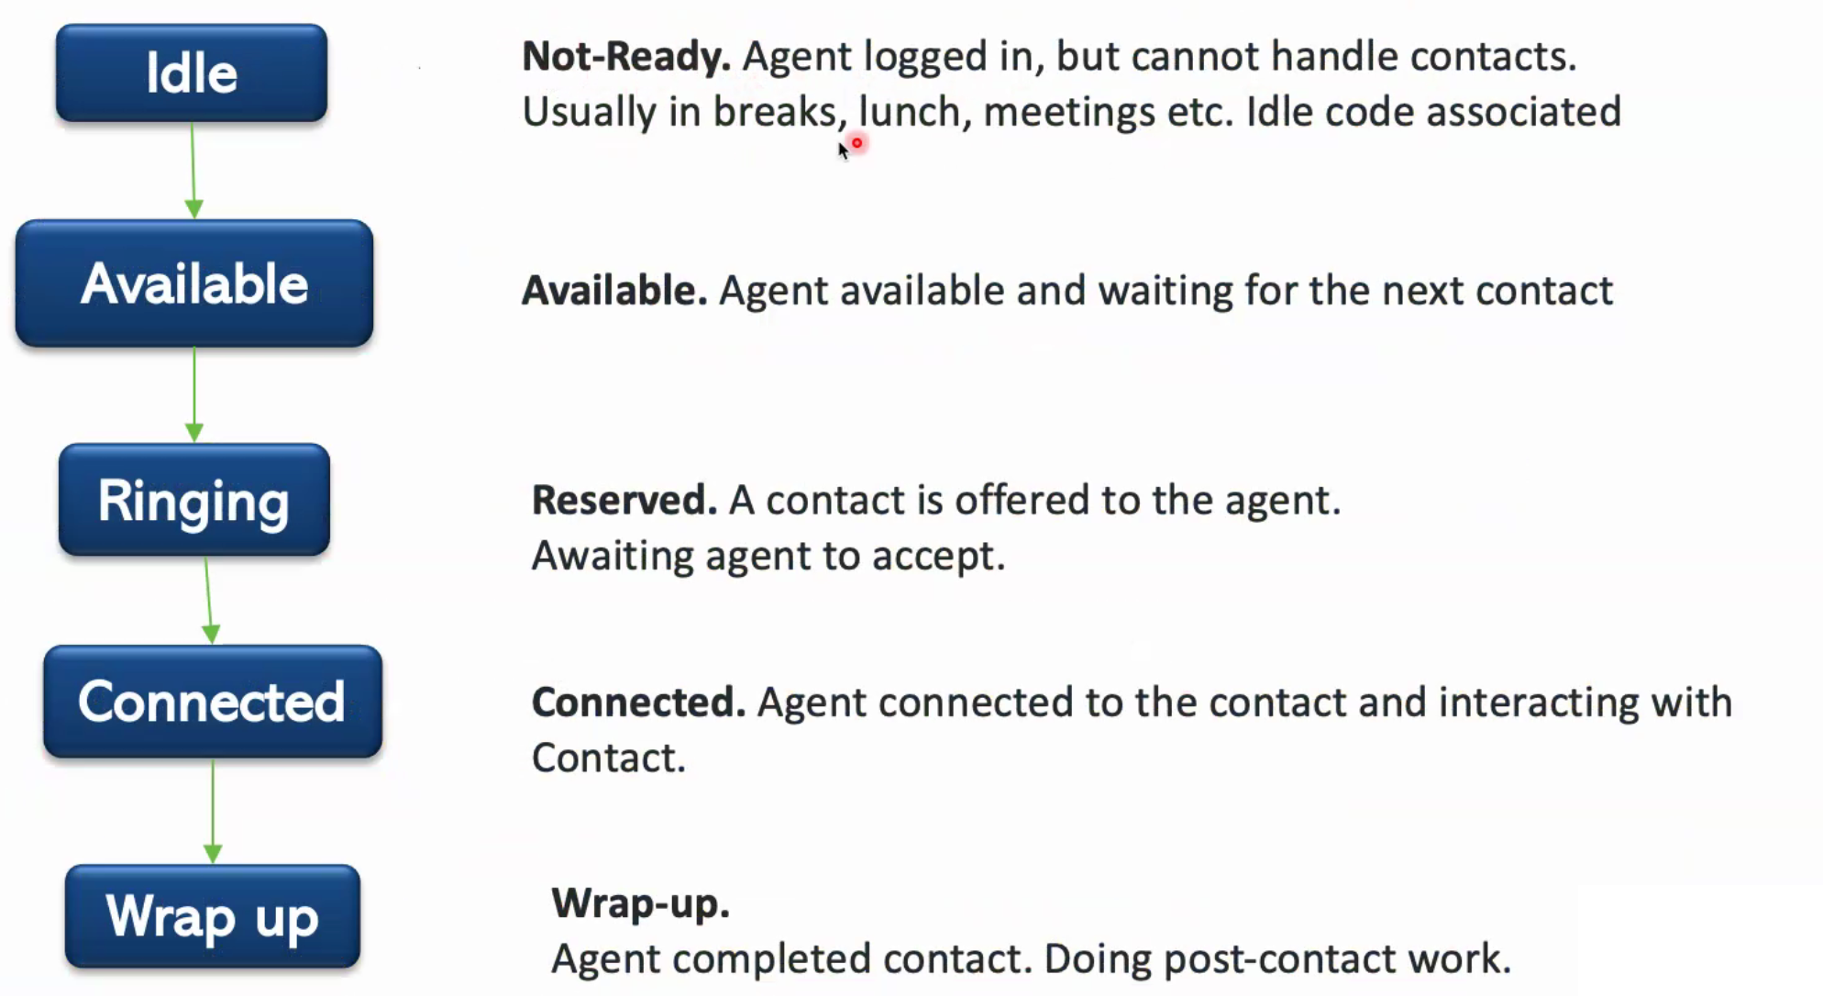
Agent Activity States (Events)

Slide 17
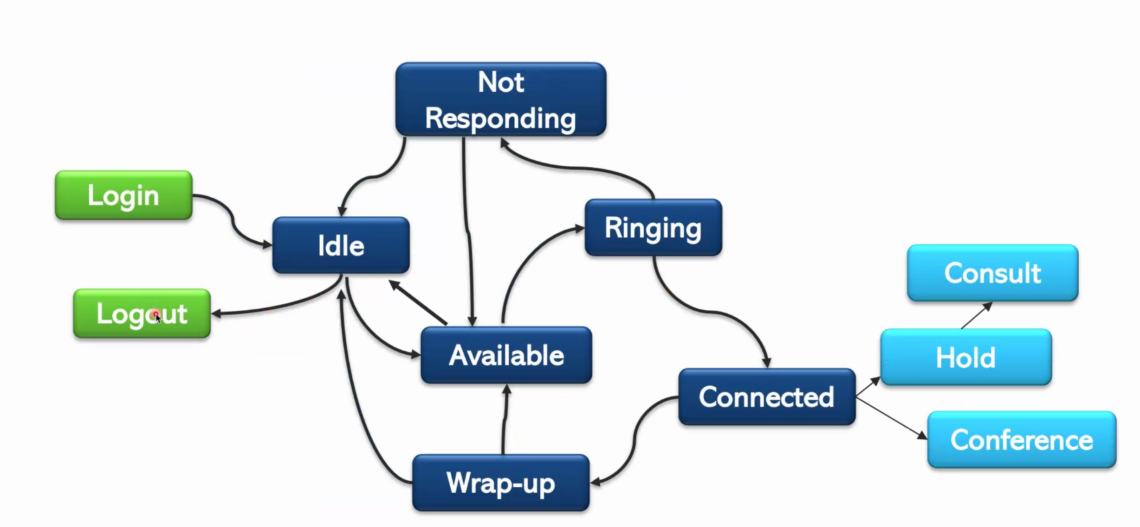
Agent State Transmition

Slide 18
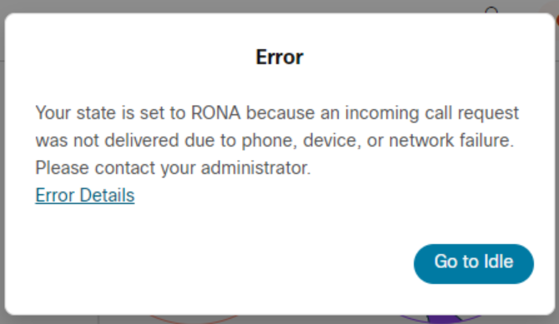
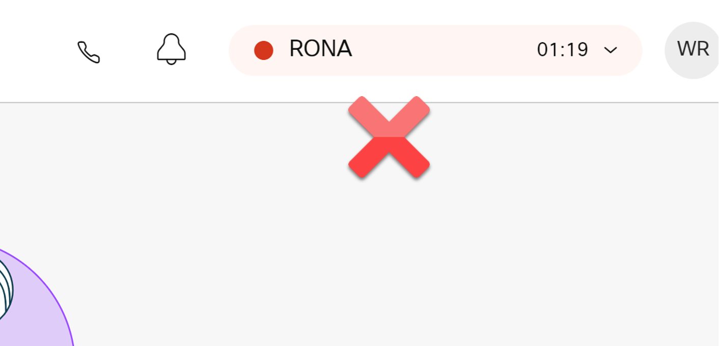
Ring On No Answer (RONA) status
Indicates the system tried to deliver a call but the connection was not established
Common Causes
Not Answering the phone when it rings (timer expires – 30 seconds)
Forgetting to go to an idle state when
Leaving your desk (restroom break, etc.)
Using phone to make other calls (direct calls, multi-line phones, etc)
Reachability issues with DN/phone line

Slide 19
Manage Inbound calls

Slide 20
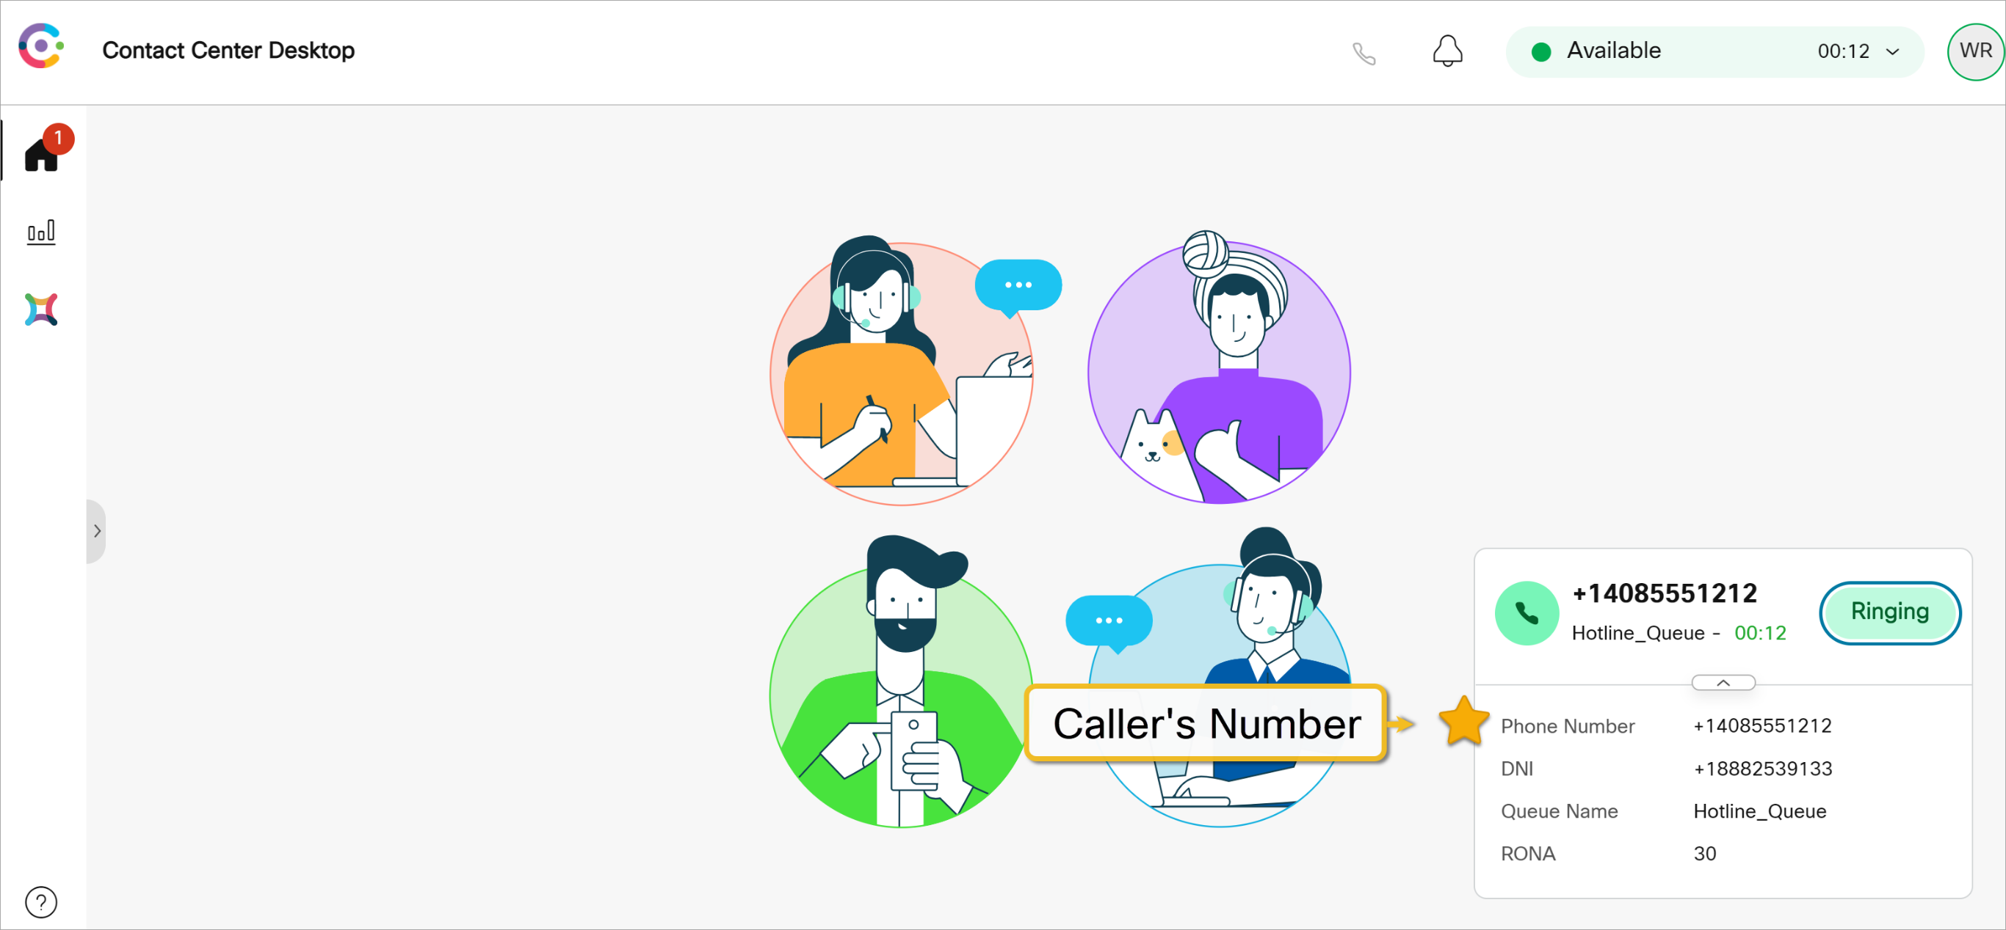
Receiving an Incoming Call
Number that customer marks

Slide 21
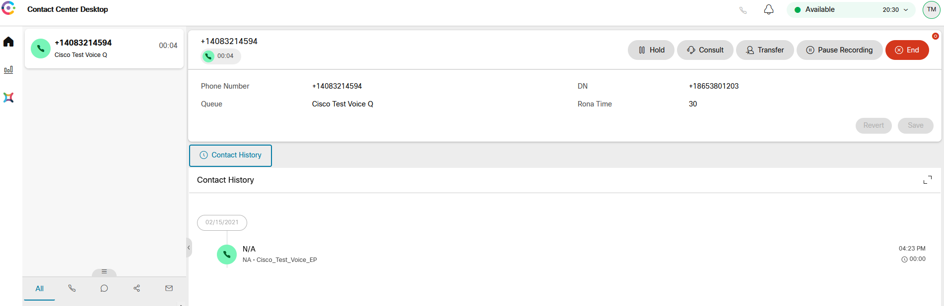
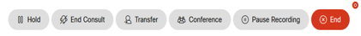
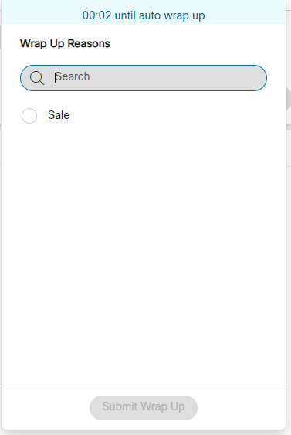
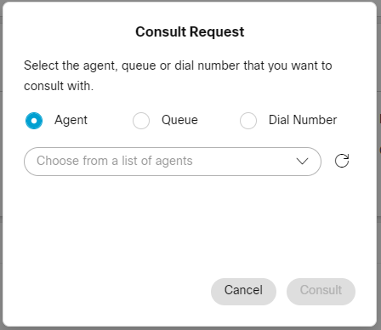
Window Controls and Indicators
Controls are available in the call
Hold will place the caller on hold and they will hear music
Consult will do a consult transfer allowing you to consult with the person you are transferring TO before connecting the end customer
Transfer will do a blind transfer
Conference (if enabled) will conference several on the same call
Pause Recording will pause recording for a few seconds to allow prevention of sensitive information being recorded
End call will hang up and put you in Wrap-Up

Slide 22
Outbound Calls

Slide 23
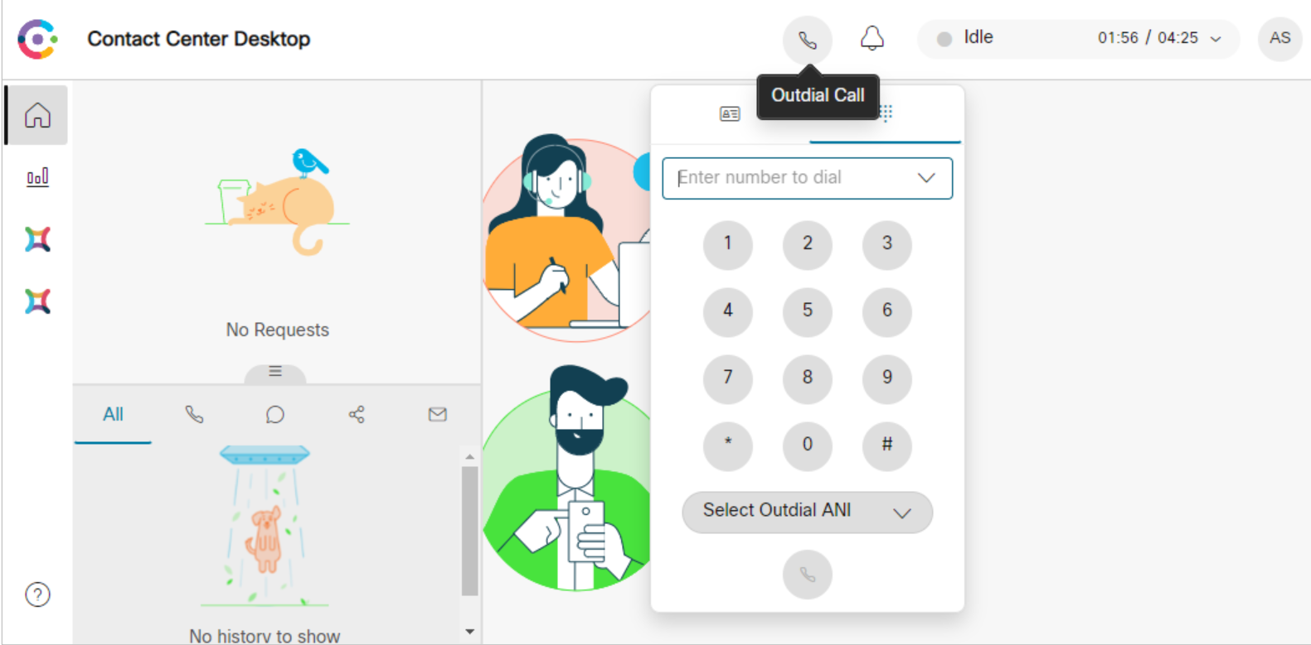
Outdial - Dialpad
Must be in IDLE state for Dialpad to function

Slide 24
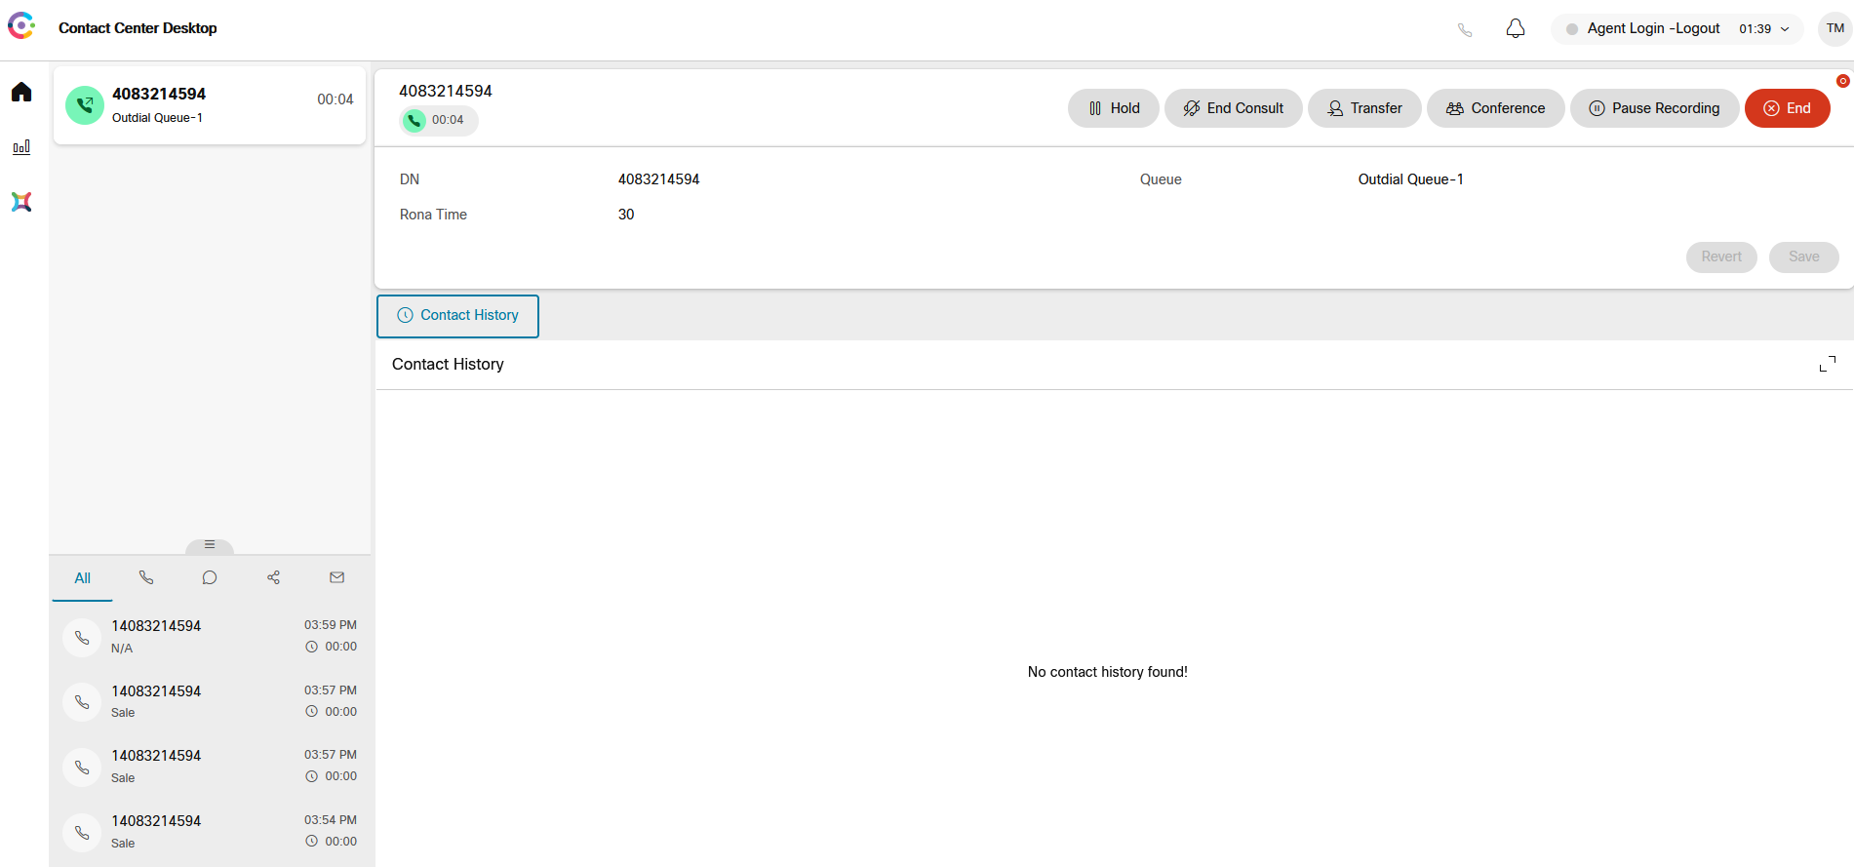
Outbound Call in Progress
2 Steps to outdial:
Agent line will ring
Dial out to called number

Slide 25
Agent Statistics

Slide 26
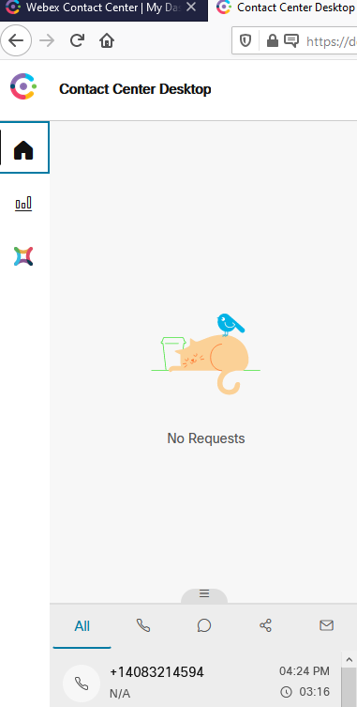
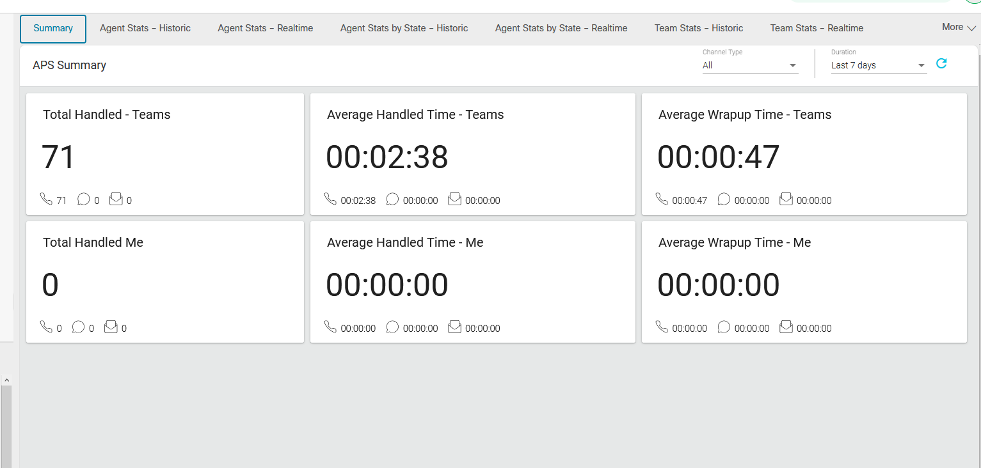
Agent Statistics

Slide 27
Help

Slide 28
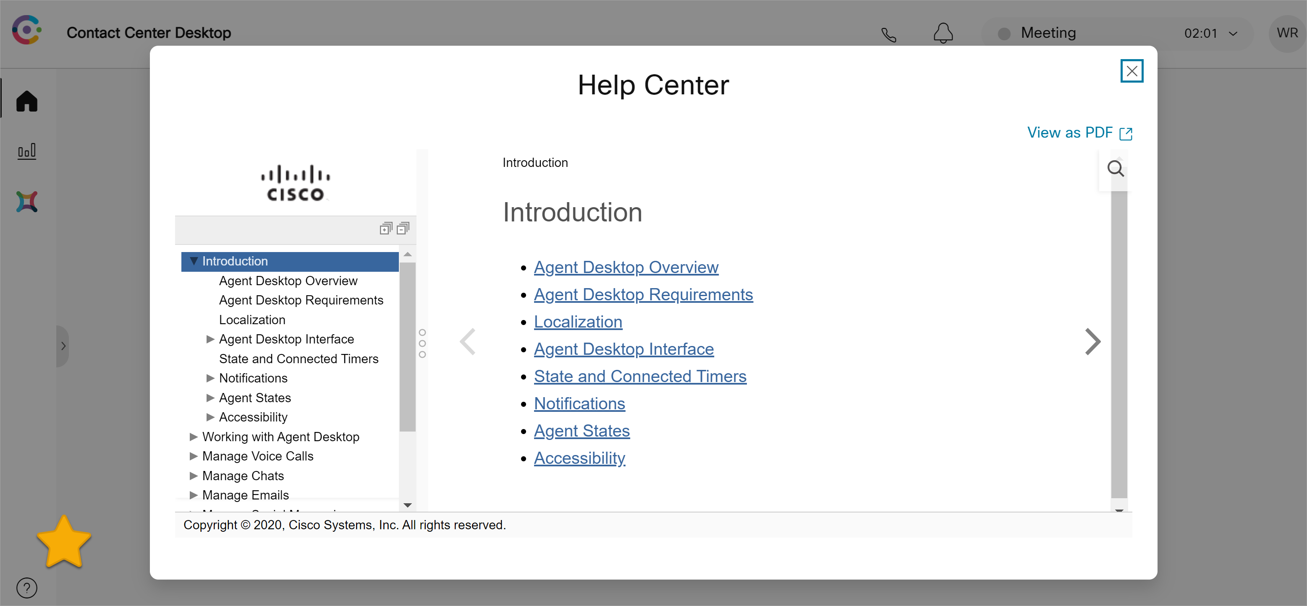
Built In Help

Slide 29
Operational Procedures to Remember
Agents must be provided with url and login information (check email for initial credentials)
https://desktop.wxcc-us1.cisco.com/
Agents must know phone number (or extension) where they are sitting
Phone numbers should be entered as numeric only (no ‘-’ and ‘+’ characters)
Agent use of Idle state
before leaving their desk
before placing outbound calls
when taking non-call center calls (direct calls; multi-line phones, etc.)
Log-out – need to log out at the end of your work session

Slide 30
Questions?

